Slide 1
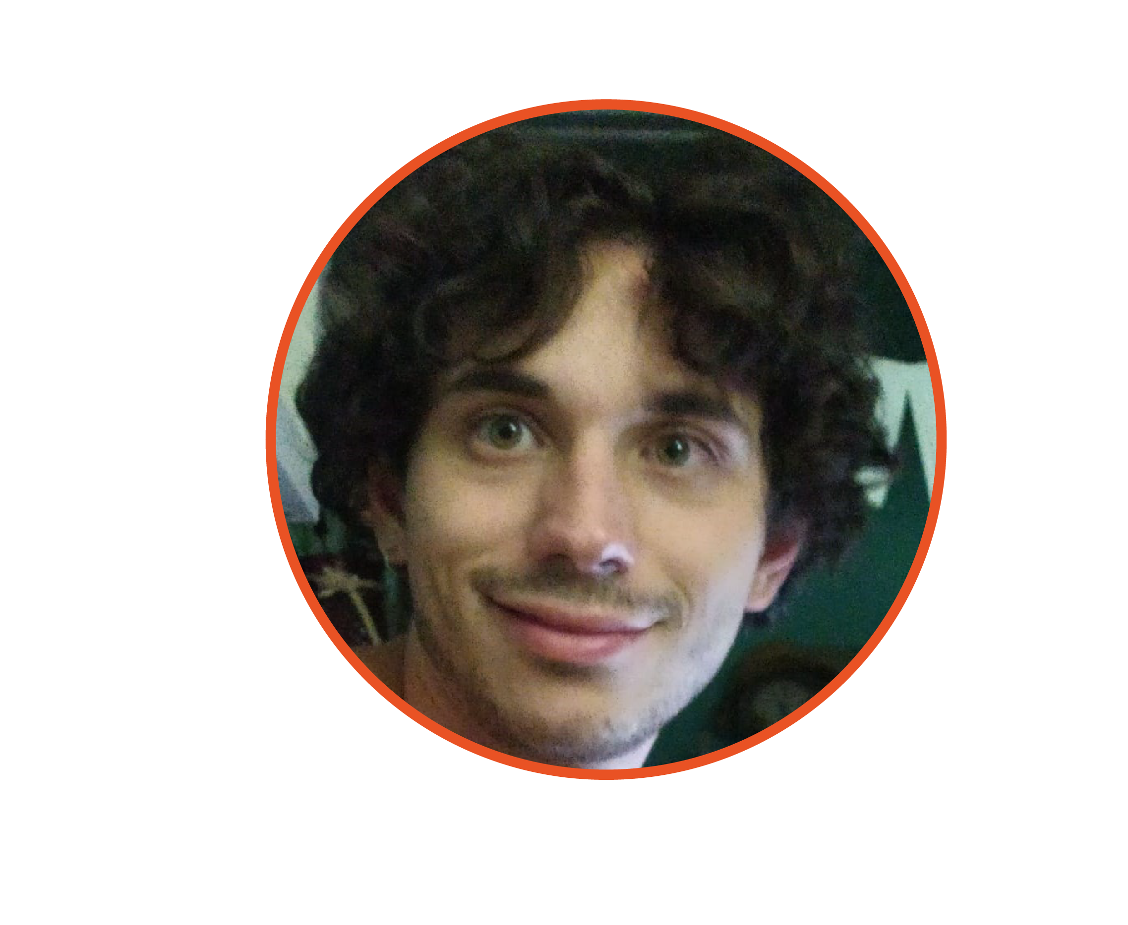
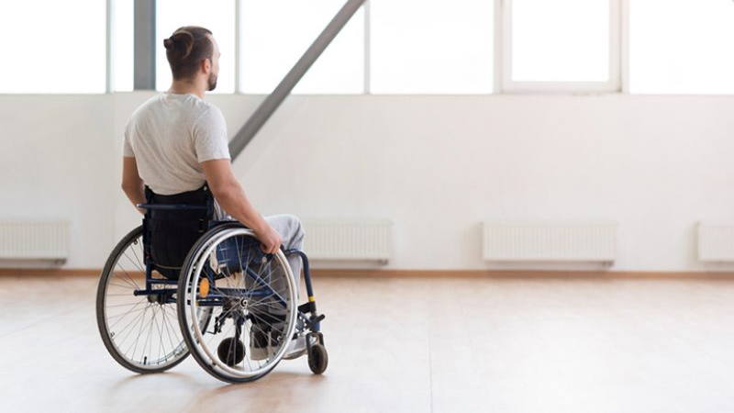



Ermanno Girardo
Robotics Engineering Student
In collaboration with
Presents:
TIAGo robot teleoperation via Body Machine Interface for cervical Spinal Cord Injured subjects assistance

Slide 2
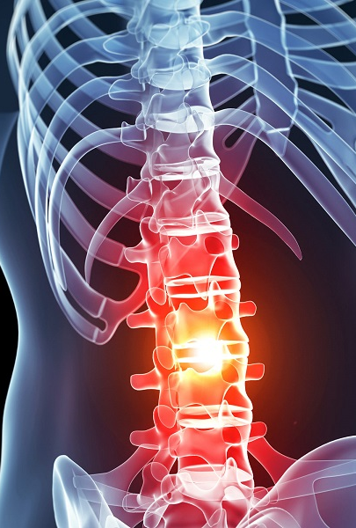
cervical Spinal Cord Injury - cSCI
cSCI is a devastating event that change the life style of a person forever
Every year, around the world, between 250 and 500 thousand people suffer SCI.
Loss of motor and/or sensory functions below the level of the lesion
The majority of cSCI people maintain limited motions of upper body
Physical rehabilitation to regain some motor skills and also supporting them psychologically
Support is needed to assist SCI subject in daily activities
Word health Organization – Spinal Cord Injury

Slide 3
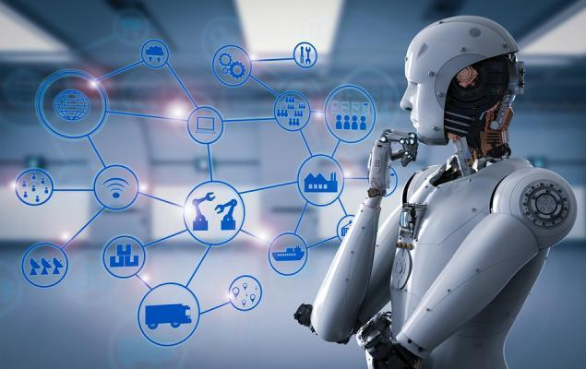
Supportive and Rehabilitative Robotics
In the last decades a lot of studies have been made that led to the birth of robotics technologies to assist and to rehabilitate ele
The fields of assistive and rehabilitative robotics exploits existent and powerful technologies in order to build very complex system to
Assist subjects in daily activities
Assist doctors and physiotherapists doing rehabilitation
Assistive robot can be distinguished in two classes:
Mobile or fixed based robot
Let’s see now couple of existing technologies

Slide 4
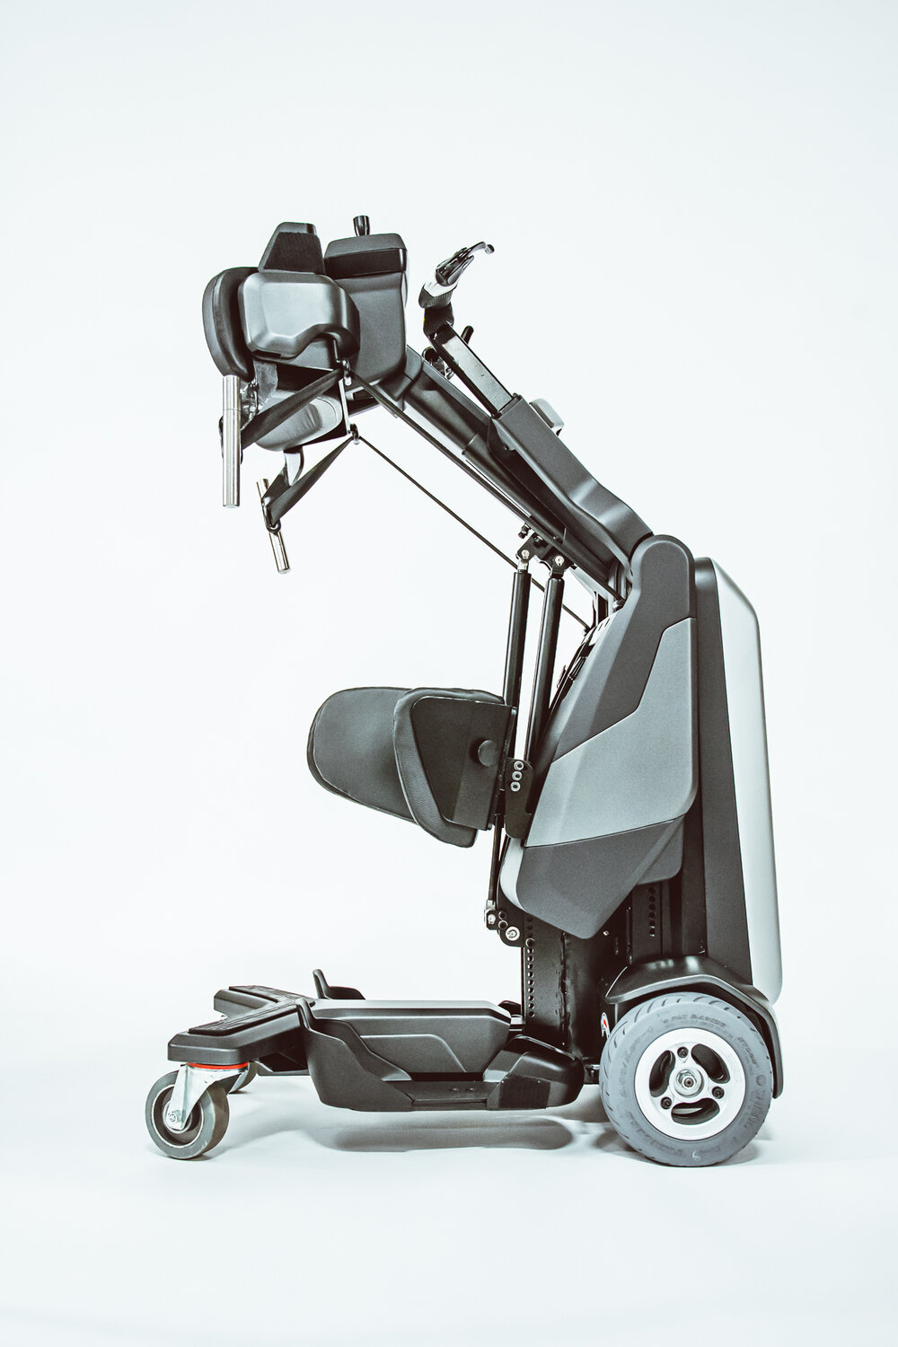
TEK RMD
Mobile assistive robot developed by MATIAS robotics in 2020
It is thought to enable people in wheelchair to goes around in the environment
Equipped with GPS is able to reach source signal
It is ideal for paraplegics or those with compromised walking and standing abilities
Cons: It is needed good upper limb and hand function
For a demonstrative video click here
Anatomical Concepts – The TEK RMD from Matias Robotics

Slide 5
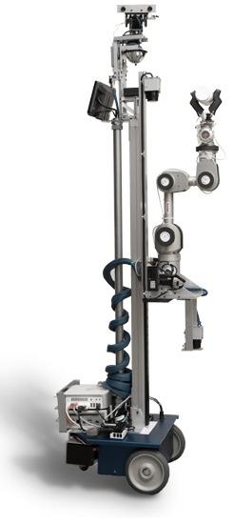
El-E robot
Mobile assistive robot, El-E developed by Georgia Institute of Technology in 2008
This is one of the first assistive robot that is aimed to help people suffering from certain disabilities and motor impairments
El-E is able to pick up and bring objects from the floor thanks to its gripper
Trough a laser pointer the user is able to assign a target to grasp
Through its camera it is able to identify the target position and orientation in 3D space
For a demonstrative video click here
Healthcare Robotics Lab – El-E an assistive Robot , March 2009

Slide 6
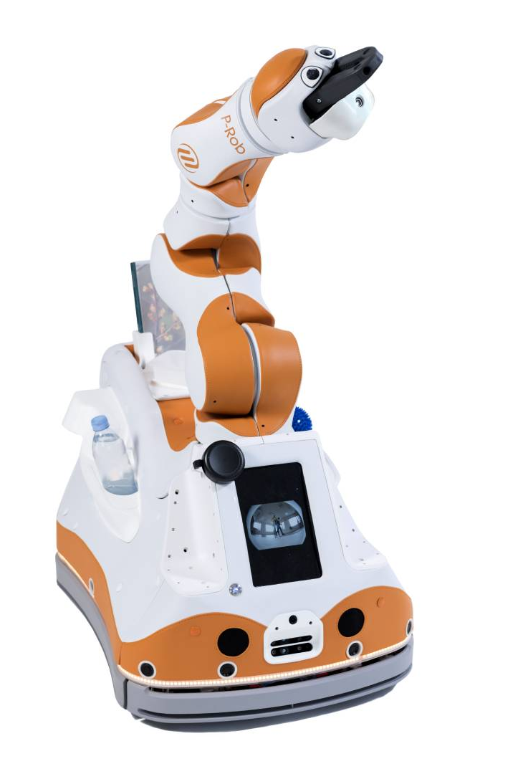
LIO robot
Developed by F&P Personal Robotics in 2018, is a fully autonomous mobile robot with a multi-functional arm explicitly designed for human-robot interaction and personal care assistant tasks
It was intended, at first, for provide support and assistance to employees in farms but its potential is extendable to other type of final users (i.e elderly people)
Recent studies have calculated that the number of people over 80 years of age is expected to double from 2015 to 2040
LIO is part of social/assistive robot such for example Care-O bot by Unity Robotics and Pepper by SoftBank Robotics.
For a demonstrative video click here
F&P Personal Robotics - Ihr persönlicher Assistenzroboter

Slide 7
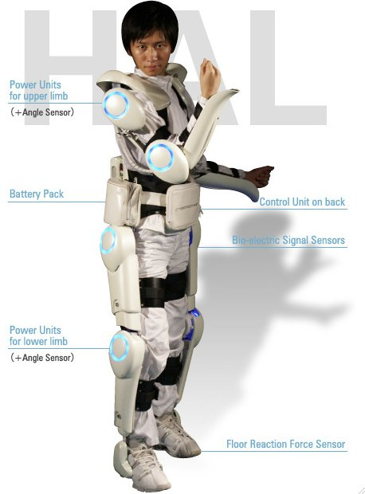
Hybrid assistive limb - HAL 5
Experts in computer science,robotics mechanics and biomedical have developed exosuit for different purposes
HAL is a powered exoskeleton suit developed by Japan's Tsukuba University and the robotics company Cyberdyne
For whom it has been thought
HAL 5 – Design and Mechanics
Cybernic Voluntary Control (CVC) & Cybernic Autonomous Control (CAC)
Pro: customizable, light (10 kg), battery life (2h 40’) – specifications for the last model HAL 5 in figure
Cons: cost (14 000$ – 19 000$)
E. A. Moore - HAL-5: The exoskeleton robot 'to suit you'

Slide 8
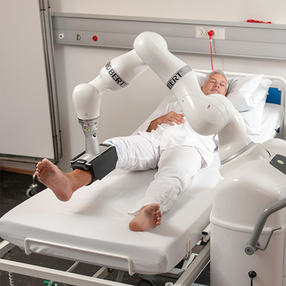
ROBERT
Developed by Life Science Robotics, ROBERT is an innovative and ground-breaking robot focusing on efficient rehabilitation and early mobilization of subjects.
Not only for patients, ROBERT provides considerable help to nursing staff
Three main functionalities:
Active Resistive Mobilization
Active Assistive Mobilization
Passive Mobilization
For a demonstrative video click here
Life Science Robotics – Meet ROBERT, The first step out of bed

Slide 9

Towards cSCI oriented assistive technology
cSCI subjects maintain limited motions of upper body that vary considerably from a subject to another
Existing assistive technologies do not fit with a global context
It is crucial for cSCI subjects to be stimulated to perform motions
Passive or fully autonomous technology is not a good idea
Solution should be completely accessible by cSCI subjects and should entice a collaboration human-robot
Key points: flexibility, user-friendly, intuitive, stimulating, rehabilitative, low cost and easily&completely accessible

Slide 10
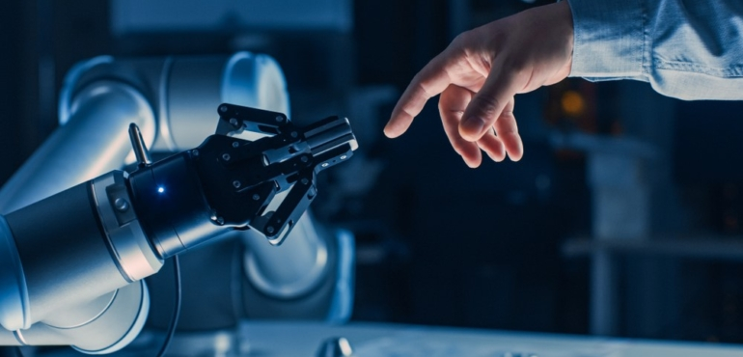
Teleoperation – A way to remotely control robots
Robot teleoperation has been studied for many centuries across application areas ranging from search-rescue, space exploration to surgery
It is used in context where fully autonomous robot are not able to plan a solution
Teleoperation allow the user to control a semi-autonomous robot remotely in real-time generating signals that will be processed and executed
Nowadays a lot of interfaces and solutions exist to teleoperate a robot (i.e joystick, pedals, speech recognition, gestures and posture recognition, MMK, fully immersive virtual reality , framework for human motion transfer ecc…)

Slide 11
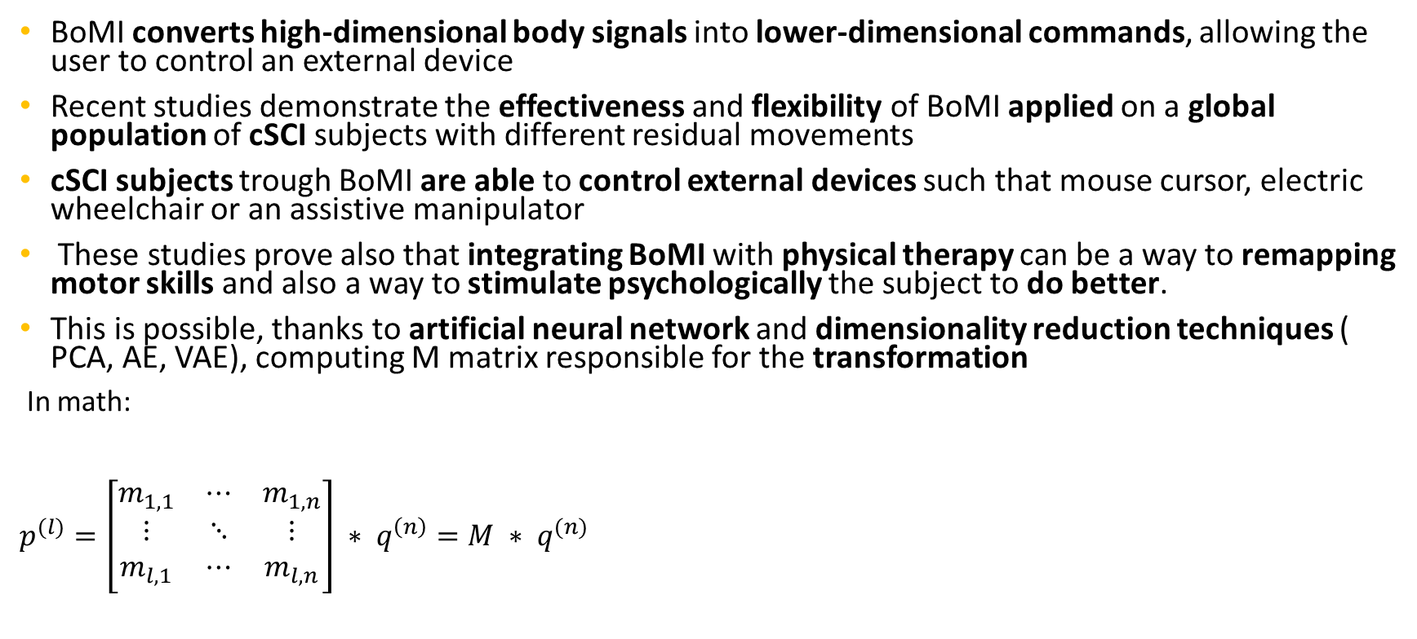
Body Machine Interface - BoMI
BoMI converts high-dimensional body signals into lower-dimensional commands, allowing the user to control an external device
Recent studies demonstrate the effectiveness and flexibility of BoMI applied on a global population of cSCI subjects with different residual movements
cSCI subjects trough BoMI are able to control external devices such that mouse cursor, electric wheelchair or an assistive manipulator
These studies prove also that integrating BoMI with physical therapy can be a way to remapping motor skills and also a way to stimulate psychologically the subject to do better.
This is possible, thanks to artificial neural network and dimensionality reduction techniques ( PCA, AE, VAE), computing M matrix responsible for the transformation
In math:
$p^{(l)}=\left[\begin{matrix}m_{1,1} & ⋯ & m_{1,n} \\ ⋮ & ⋱ & ⋮ \\ m_{l,1} & ⋯ & m_{l,n}\end{matrix}\right] ∗ q^{\left(n\right)}=M ∗ q^{(n)}$
C. Pierella, M. Casadio et Al. Recovery of Distal Arm Movements in Spinal Cord Injured Patients with a Body-Machine Interaface, 2021

Slide 12
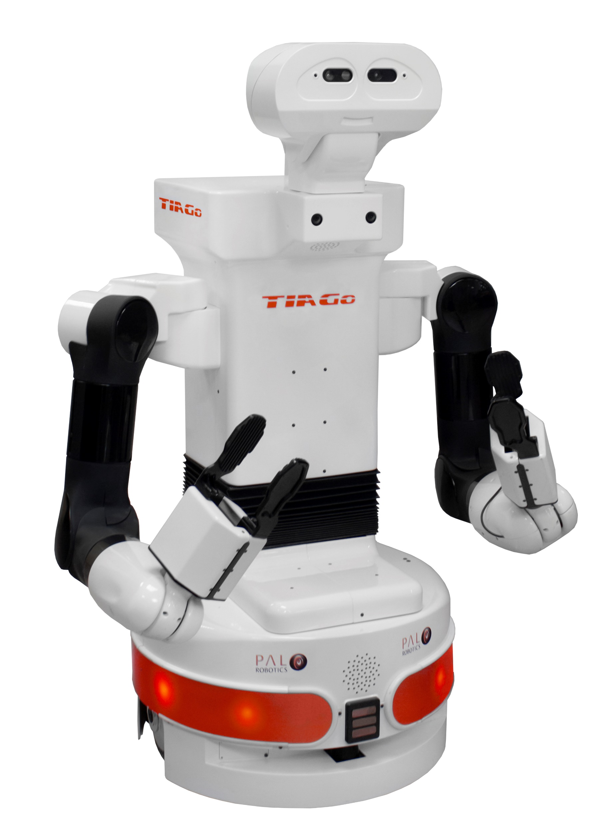
TIAGo Robot
Developed by PAL – Robotics TIAGo is mobile manipulator-based service robot
Some technical specifications
Recent studies prove TIAGo adaptablity in a real-word scenario for assistive task and its potential
Short-Term Human–Robot Interaction Adaptability in Real-World Environments, A. Andriella et Al. , December 2019

Slide 13
TIAGo Robot
Developed by PAL – Robotics TIAGo is mobile manipulator-based service robot
Some technical specifications
Recent studies prove TIAGo adaptablity in a real-word scenario for assistive task and its potential
In collaboration with Accerion, It was used in hospitals during COVID emergency to support medical staff
Robots as intelligent assistants to face COVID-19 pandemic, V. Seidita et Al.

Slide 14
TIAGo Robot
Developed by PAL – Robotics TIAGo is mobile manipulator-based service robot
Some technical specifications
Recent studies prove TIAGo adaptablity in a real-word scenario for assistive task and its potential
In collaboration with Accerion, It was used in hospitals during COVID emergency to support medical staff
It was used with CARESSER for social assistance to elderly people
Introducing CARESSER: A framework for in situ learning robot social assistance from expert knowledge and demonstrations, A. Andriella et al.

Slide 15
TIAGo Robot
Developed by PAL – Robotics TIAGo is mobile manipulator-based service robot
Some technical specifications
Recent studies prove TIAGo adaptablity in a real-word scenario for assistive task and its potential
In collaboration with Accerion, It was used in hospitals during COVID emergency to support medical staff
It was used with CARESSER for social assistance to elderly people
TIAGo is also used in nursing homes to support and assist elederly or people with disablities

Slide 16
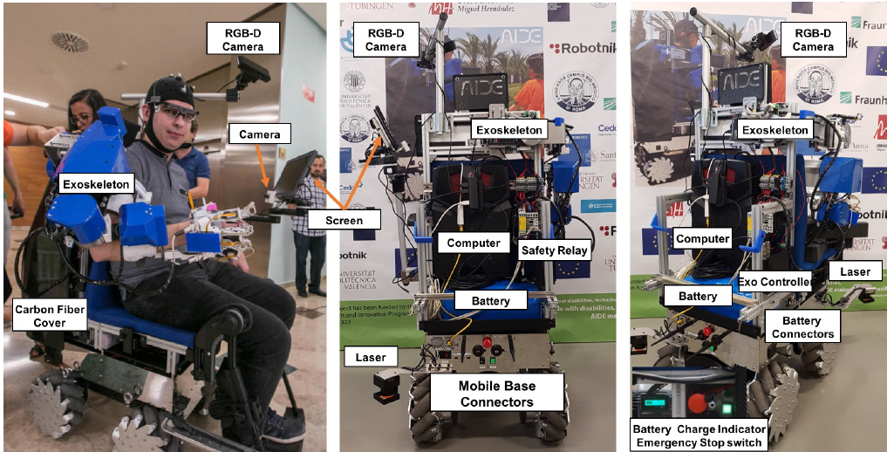
A recent interest study
Fully autonomous mobile robotic platform to support elderly and people with different degrees of disability
Complex hardware setup, functionalities and different biosignals acquisition
Three end users groups with different residual capabilities
Extension to assistive robots such as: TIAGo, Care-O-Bot and PR2
Evaluation based on activities of ADL using different interfaces
Results
Pro: modularity, fully autonomous
Cons: very complex, not accessibile autonomously, invasive
M. Catalan, A. Bianco et Al, A Modular Mobile Robotic Platform to Assist People with Different Degrees of Disability, 2021

Slide 17
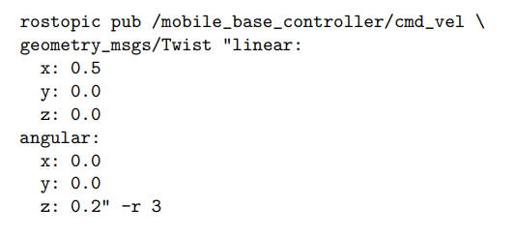
How to control TIAGo mobile base?
Since it is a non-holonomic mobile robot it is not able to translate across the direction of the wheels, then in order to change direction an angular velocity has to be specified
In particular to move TIAGo base, a Twist message has to be published with a certain rate, on a specific topic
ROS plugins demanded of controlling wheels velocity will receive our Twist message and will actuate the corresponding motors on the basis of the specified velocities.
http://wiki.ros.org/Robots/TIAGo/Tutorials/motions/cmd_vel

Slide 18

How to control TIAGo arm?
Thanks to MoveIt!, an easy-to-use open source robotics manipulation platform already presents and configured into TIAGo.
MoveIt, knowing the description of the robot (URDF), compute a trajectory for all the joints of the arm, for this reason is possible to control TIAGo arm in two separete ways:
Planning in Cartesian Space- specifying the 6DoF goal position for e.e
Planning in Joint Space – specifying the position for all the joints
It is needed to specify the MoveIt! planning group before planning a goal – for our scope is the torso-arm group which includes the joint for the torso and the seven joints for the arm
In case the user planning in Cartesian Space, will publish a collision pose or an unreachable one, MoveIt is able to avoid this configurations using a plugin: Collision-Aware IK

Slide 19
Dimensionality Reduction – Techniques
Real-world data, such as speech signals, digital photographs, EEG (Electroencephalography) signals, EMG (Electromyography) signals, data acquired from body motion, usually all these signals has high dimensionality.
In order to handle such real-world signals, its dimensionality should be reduced.
Several DR techniques are commonly used in order to control external devices
Principal Component Analysis (PCA)
Autoencoder (AE)
Variational Autoencoder (VAE)
Possibility to use different body parts to control mouse cursor (nose, eyes, shoulders, right forefinger and fingers)
Video-Based Markerless VS EMG acquisition
Application of DR techniques for controlling mouse cursor

Slide 20
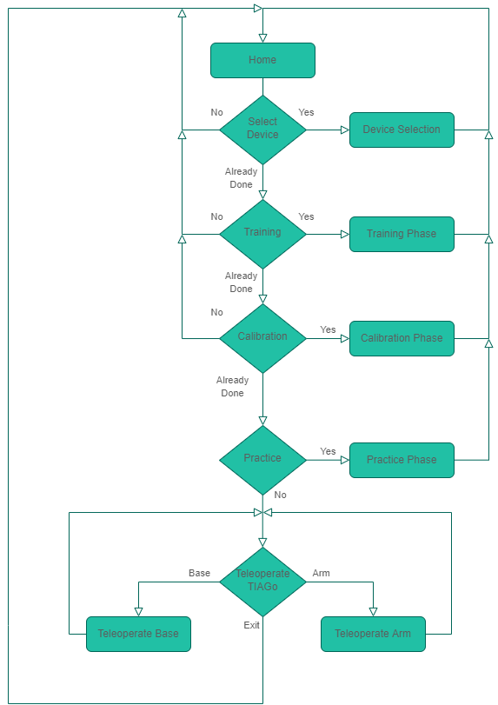
Mixing BoMI and teleoperation for cSCI subjects assistance
Having understood how well BoMI fits with cSCI subjects it is now time to think how to mix BoMI and TIAGo teleoperation for cSCI subjects assistance
The goal is to implement an interface that is intuitive and easy to use but effective
The wanted final result will be: allow cSCI subjects to teleoperate a robot using residual body motion in a fully autonomous way, in order to perform assistive tasks
Flexibility – Two different BoMIs
Communication – TCP/IP Socket Connection
Final State Machine

Slide 21
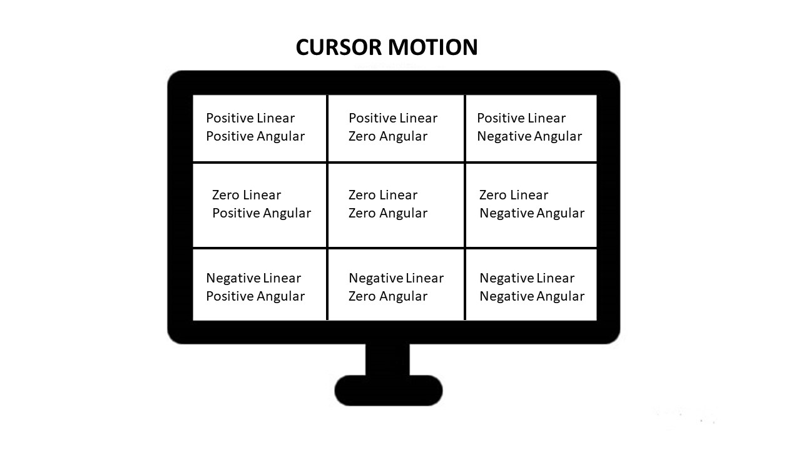
GUI Implementation - Mobile Base 1.0
In order to fully teleoperate differential mobile base of TIAGo and its arm is necessary to implement ad hoc GUIs
The subject should be able to select the angular and linear velocity, moving the mouse cursor on the screen using his residual body movements.
Linear mapping – cursor position/velocity
Operation
Cons: user continous movement , maintaining the same position for a long time

Slide 22
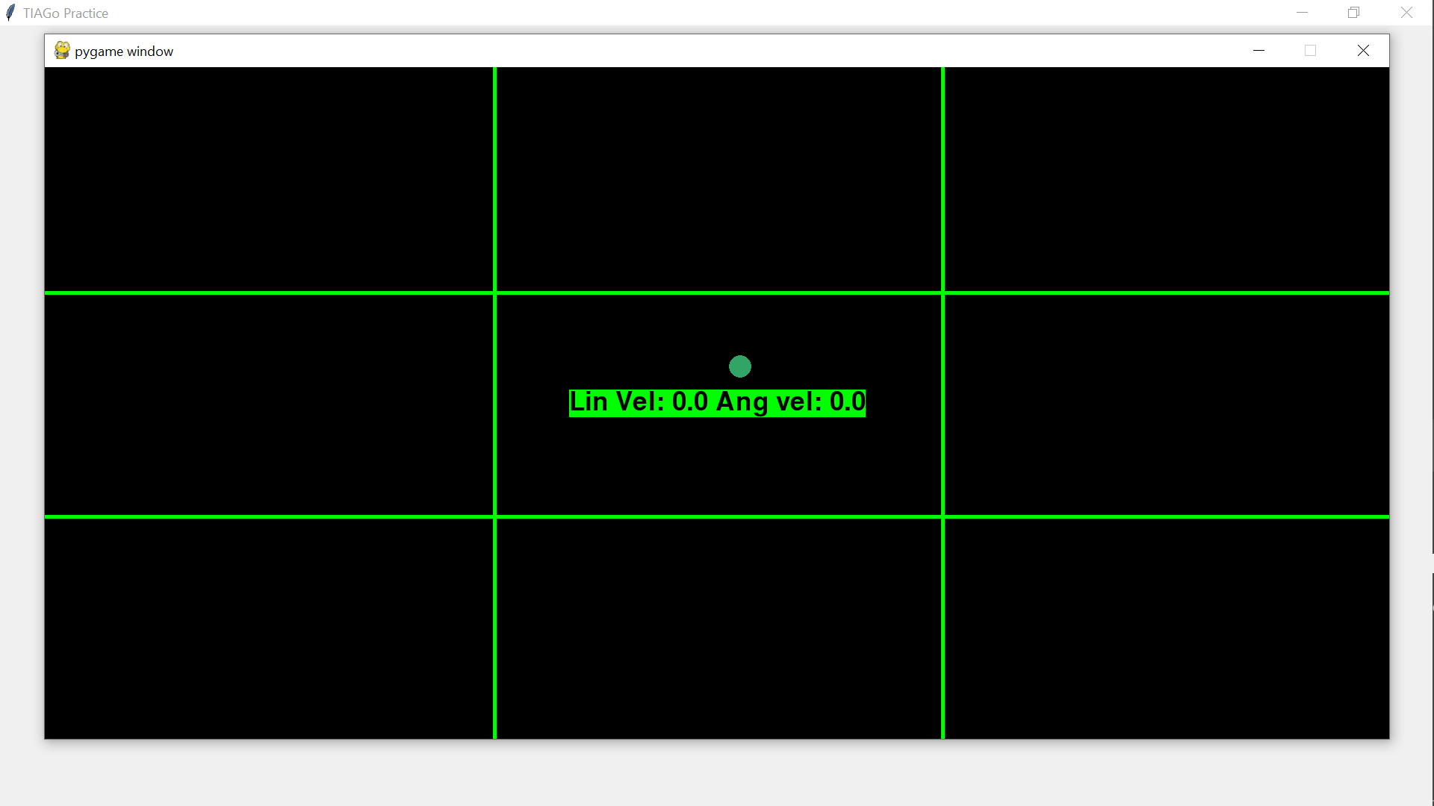
GUI Implementation - Nine Regions GUI
Made with Pygame

Slide 23
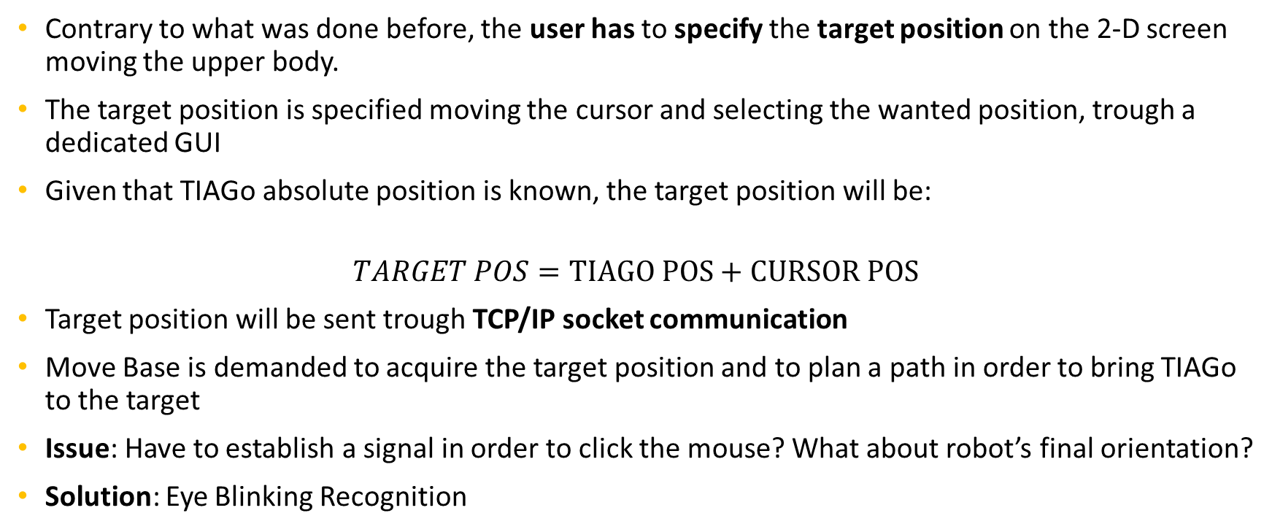
GUI Implementation – Mobile Base 2.0
Contrary to what was done before, the user has to specify the target position on the 2-D screen moving the upper body.
The target position is specified moving the cursor and selecting the wanted position, trough a dedicated GUI
Given that TIAGo absolute position is known, the target position will be:
$$TARGET POS=TIAGO POS+CURSOR POS$$
Target position will be sent trough TCP/IP socket communication
Move Base is demanded to acquire the target position and to plan a path in order to bring TIAGo to the target
Issue: Have to establish a signal in order to click the mouse? What about robot’s final orientation?
Solution: Eye Blinking Recognition

Slide 24
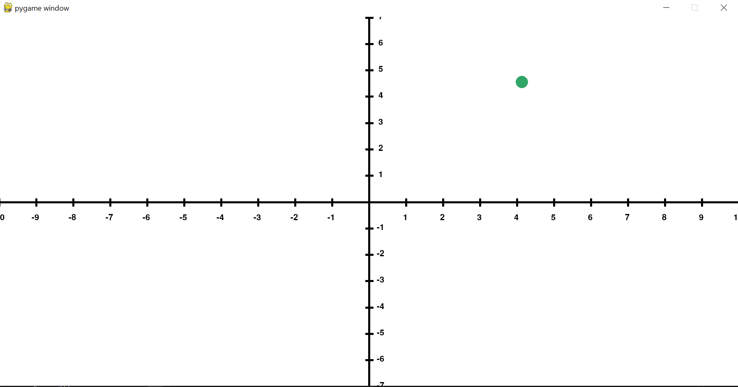
GUI Implementation – Odom GUI
Made with pygame

Slide 25
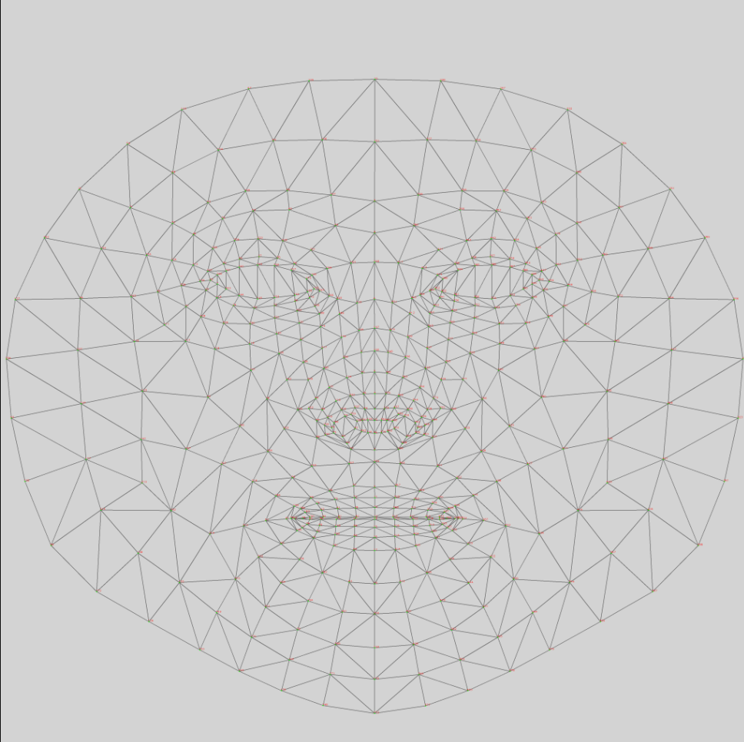
Eyes Blinking Detection – With MediaPipe
Developed by Google, MediaPipe offers open source cross-platform, customizable ML solutions for live and streaming media.
Among the many functionalities it offers, there is the possibility to detect an human face.
It creates a graph of the face that you can use for your purposes.
I use it in order to create a thread that detect eyes blinking, more generally eyes closure.
To establish a threshold for eyes closure, I insert into the program a preliminary calibration of 10 seconds.
Google MediaPipe Face Mesh

Slide 26
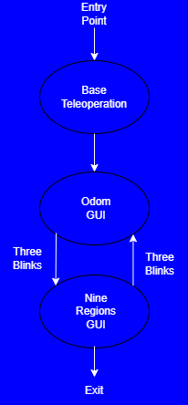
Eyes Blinking Detection – For Teleoperating TIAGo Mobile Base
The user has the possibility to switch between the states of the FSM thanks to the custom Eyes Blinking Detector thread.
In particular trough three blinks the user switch from one GUI to the other one, as you can see in the figure
Closing the eyes for 1 second the user has the possibility to select and send a target position in the «odom GUI»

Slide 27
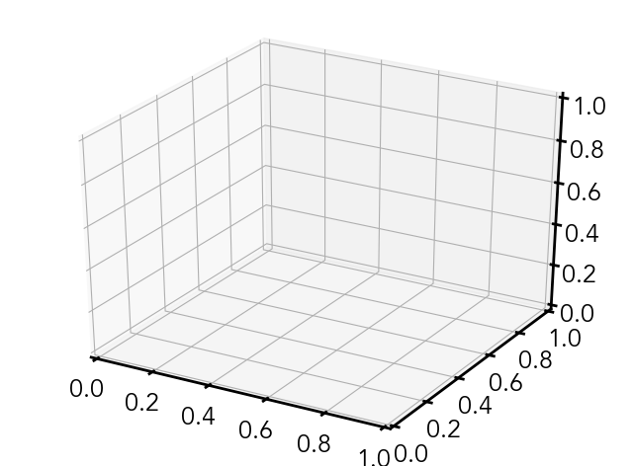
Teleoperate the arm
Planning in Cartesian Space
Shoulder motion, PCA model , extract three components
Pro: Joints position is established by the planner, fast to use
Cons: It is not simply to understand the distance from the robot, since the image belongs to a 2D plane
Assumption: Gripper orientation is assumed to be parallel to the ground

Slide 28
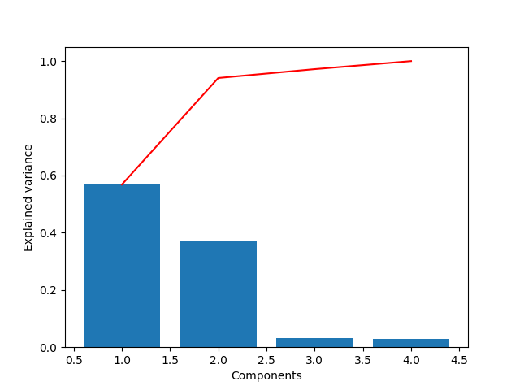
The variance explained by PCA
Since the objective of this master thesis is to teleoperate TIAGo simply with shoulder motion (4 components input vector), it is important to understand how the variance is explained on the components
Using only shoulders is impossible to extract three components, since the variance is almost completely explained by the first two components
First run using shoulder motion

Slide 29
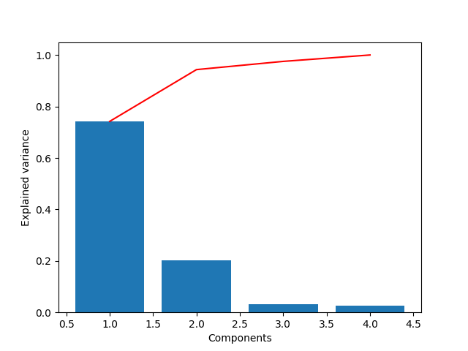
The variance explained by PCA
Since the objective of this master thesis is to teleoperate TIAGo simply with shoulder motion (4 components input vector), it is important to understand how the variance is explained on the components
Using only shoulders is impossible to extract three components, since the variance is almost completely explained by the first two components
Second run using only shoulders

Slide 30
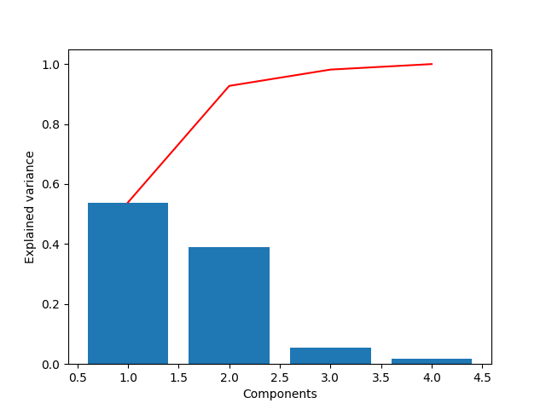
The variance explained by PCA
Since the objective of this master thesis is to teleoperate TIAGo simply with shoulder motion (4 components input vector), it is important to understand how the variance is explained on the components
Using only shoulders is impossible to extract three components, since the variance is almost completely explained by the first two components
Third run using only shoulders

Slide 31
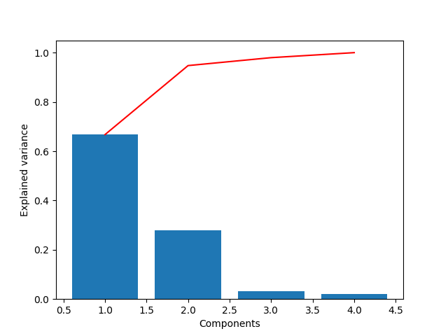
The variance explained by PCA
Since the objective of this master thesis is to teleoperate TIAGo simply with shoulder motion (4 components input vector), it is important to understand how the variance is explained on the components
Using only shoulders is impossible to extract three components, since the variance is almost completely explained by the first two components
Fourth run using only shoulders
Conclusion: It is not possible to extract 3 controllable components

Slide 32
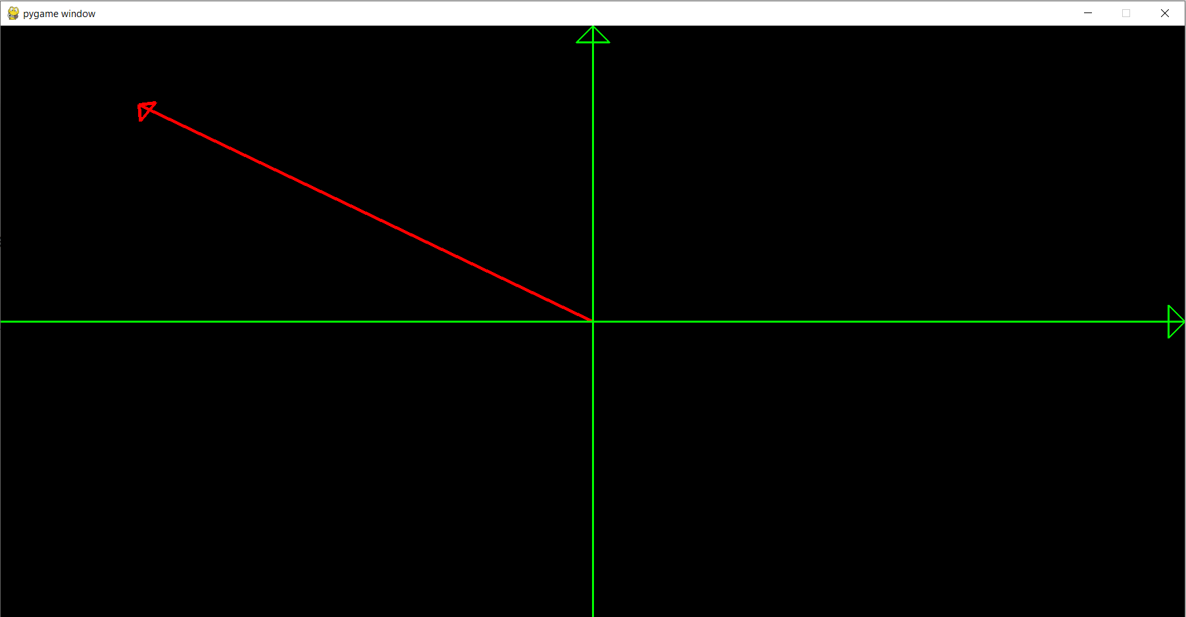
Teleoperate the Arm – GUI Implementation
A possible solution to teleoperate the arm with only two components is to split the information into two distinct GUI.
The first one will control the arm on a 2D plane
Using the position of the cursor on the 2D monitor a vector will be computed and the information will be send via socket communication to the server computer
The interface has been developed with Pygame
“2D vector GUI”

Slide 33
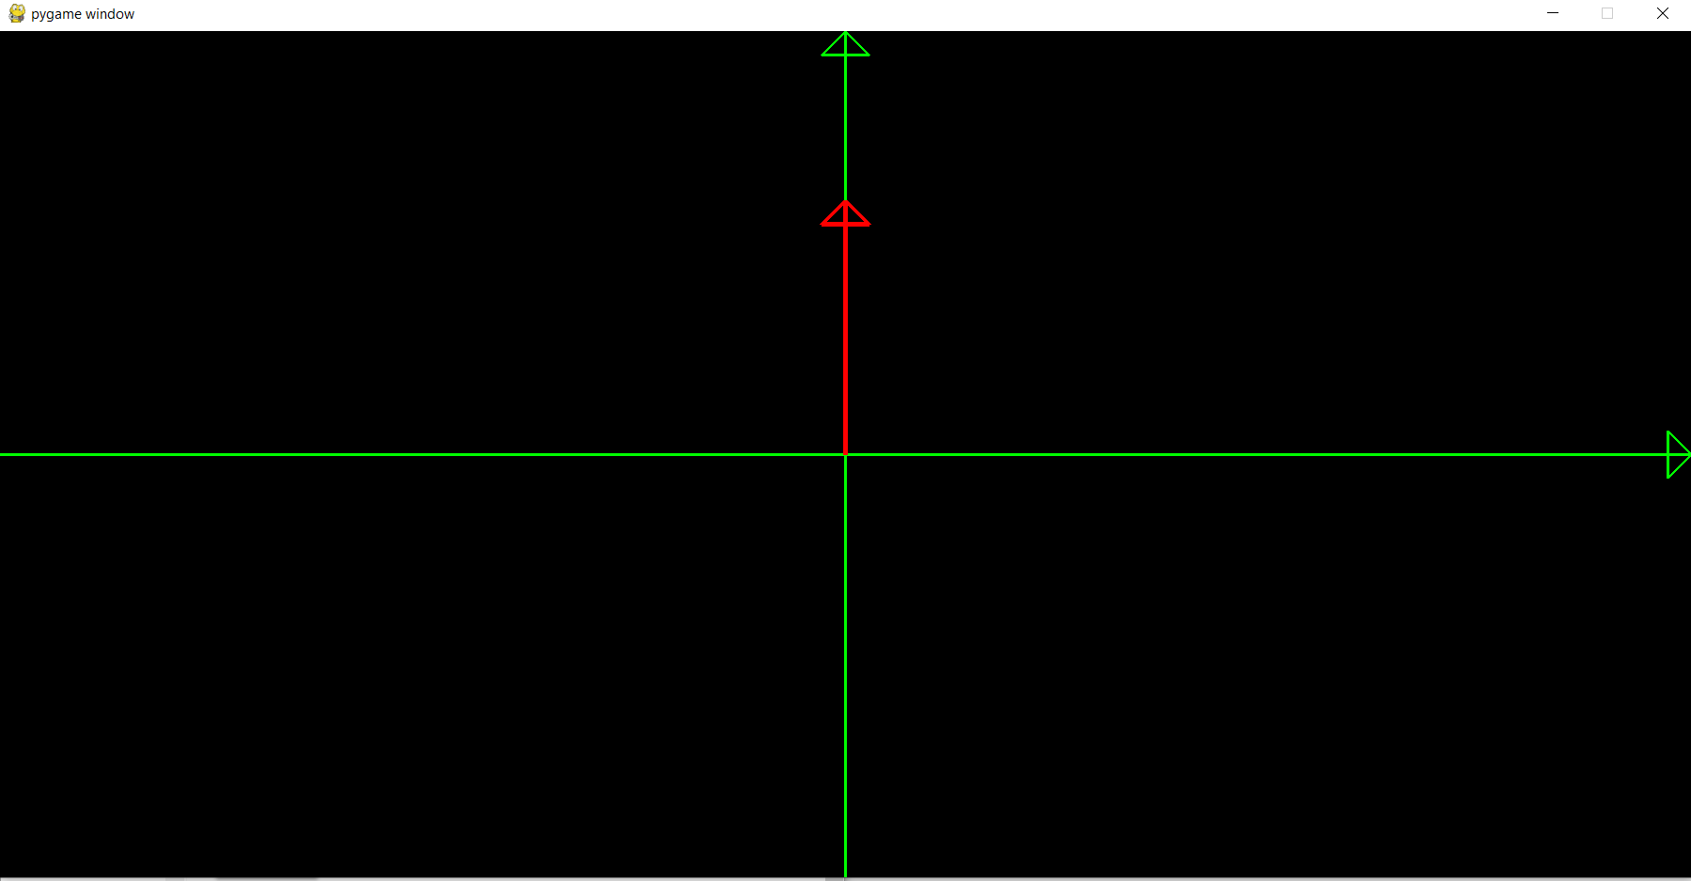
Teleoperate the Arm – GUI Implementation
A possible solution to teleoperate the arm with only two components is to split the information into two distinct GUI.
The second GUI uses the information of only one component.
In particular it considers only the y component in order to raise and lower TIAGo’s arm
The interface has been developed with Pygame
“1D vector GUI”

Slide 34
Architecture Overview – MarkerLess BoMI
On one side video-based markerless BoMI where runs the main program for handling the GUIs
Each 50 ms (acquisition rate of the webcam) 2 float numbers (linear and angular vel) and 2 integer numbers (for the target position in 2D plane) are sent trough socket communication, to a second pc and handled by ROS
ROS side each acquired frame, by TIAGo RGB-D cam, is sent trough socket communication and processed in order to compute the object position and orientation
ROS and all its components managed the simulation on Gazebo and Rviz
Finally for an implementation on TIAGo robot, ROS publishes velocities and joints informations on dedicated topics in order to teleoperate TIAGo
SLAM GMAPPING and RGB-D Camera
Move Base for autonomously navigate in the environment

Slide 35
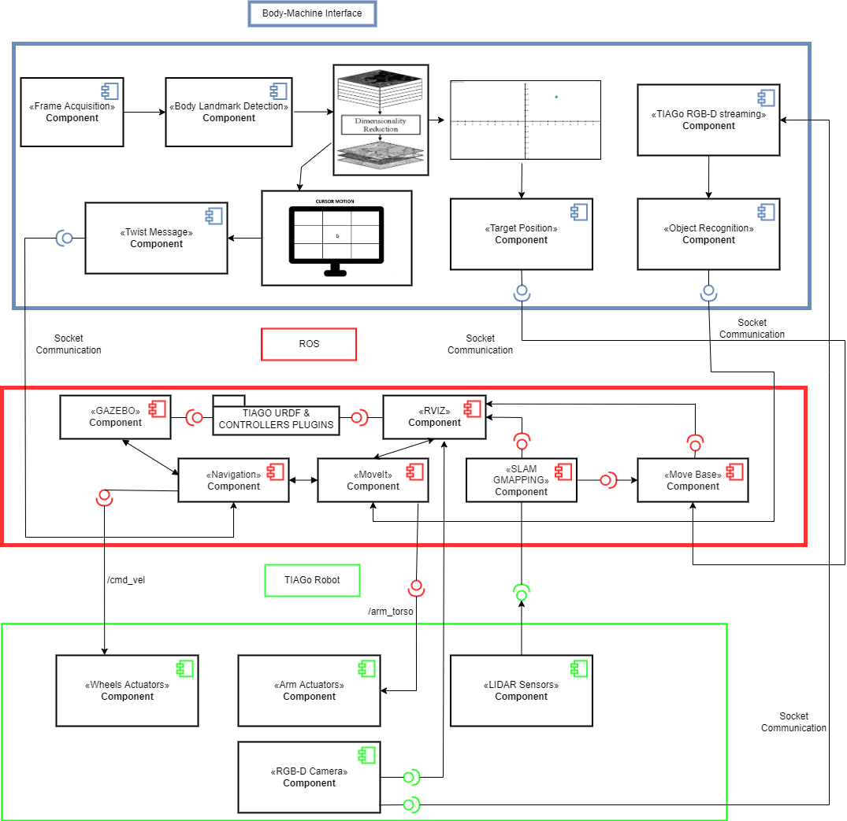
Architecture Overview – MarkerLess BoMI
Made with Draw.IO

Slide 36
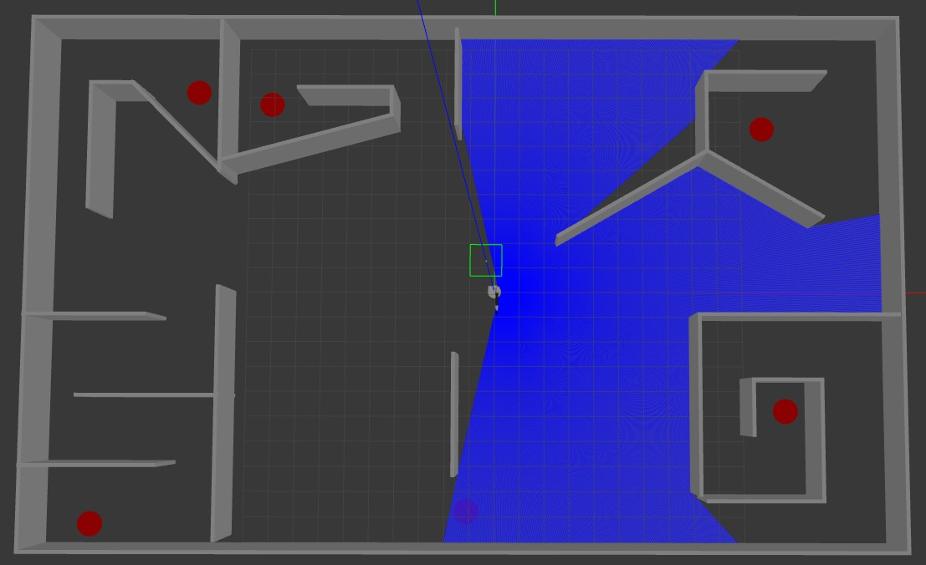
Simulation – Practice Phase
TIAGo in Gazebo and Rviz 3D simulation environments.
I have developed a scenario for the navigation practice
Goals to reach by the user in red
Developed wih Gazebo

Slide 37
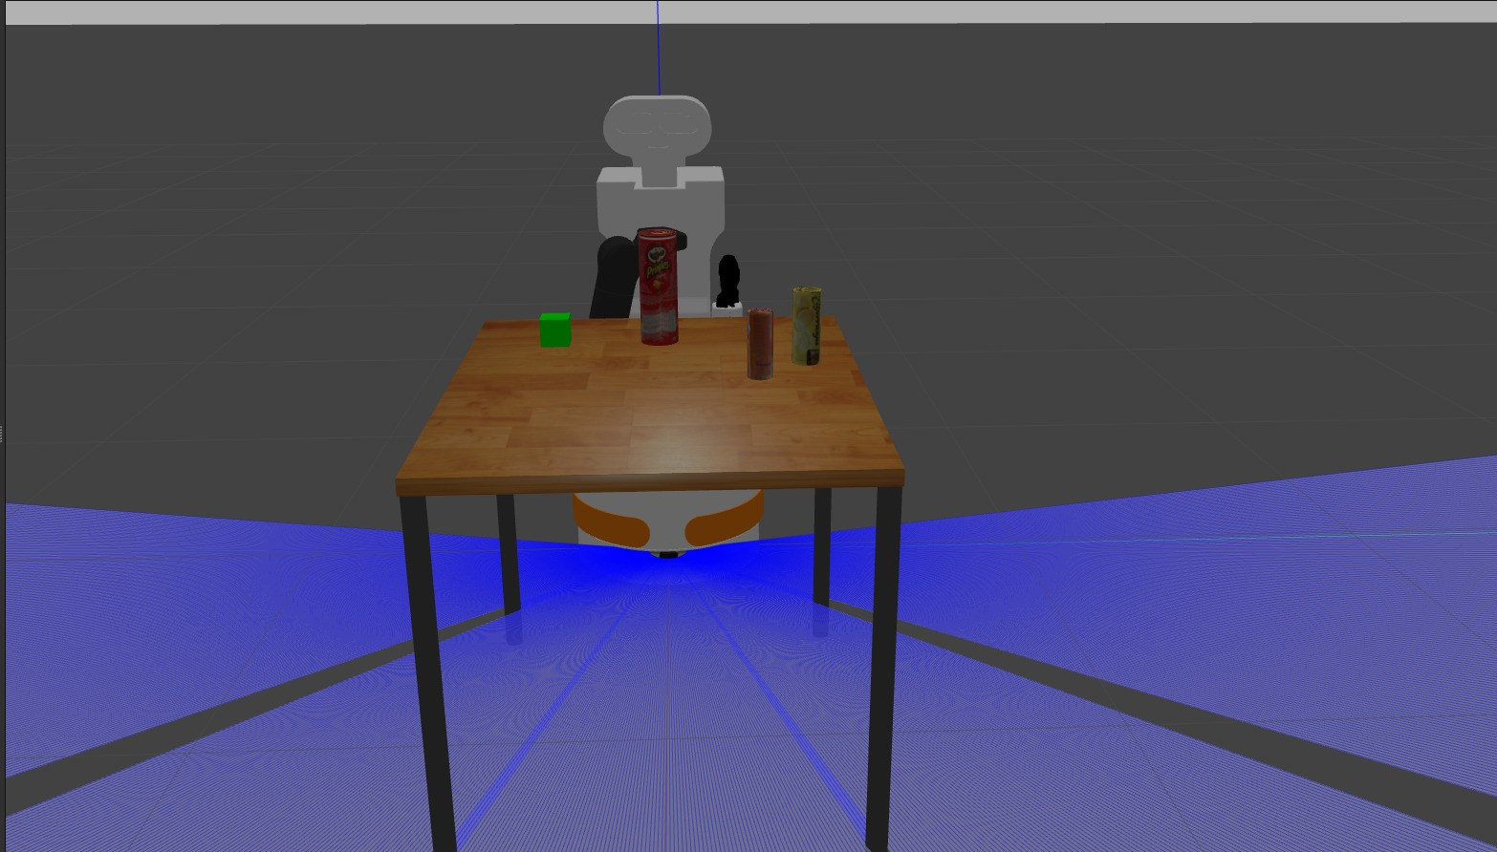
Simulation – Practice Phase
TIAGo in Gazebo and Rviz 3D simulation environments.
I have developed a scenario for the navigation practice
I chose a scene for pick and place and navigation practice
Developed wih Gazebo

Slide 38
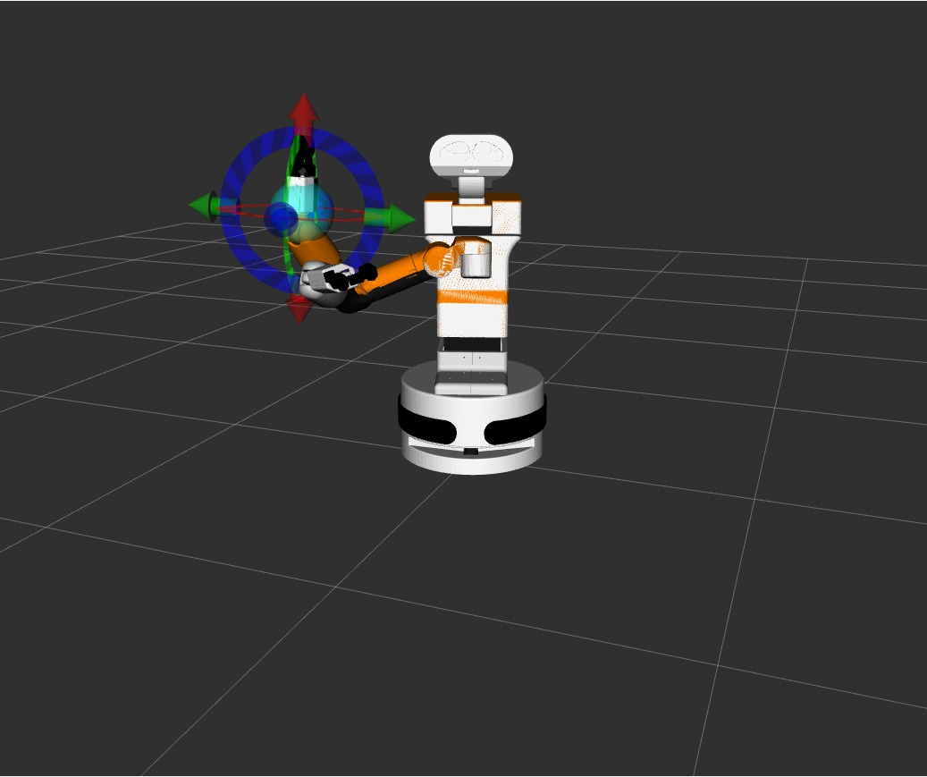
Simulation – Practice Phase
TIAGo in Gazebo and Rviz 3D simulation environments.
I have developed a scenario for the navigation practice
I chose a scene for pick and place and navigation practice
Showing MoveIt motion planner could be a good idea for better training of the arm
Developed wih Rviz and MoveIt!

Slide 39
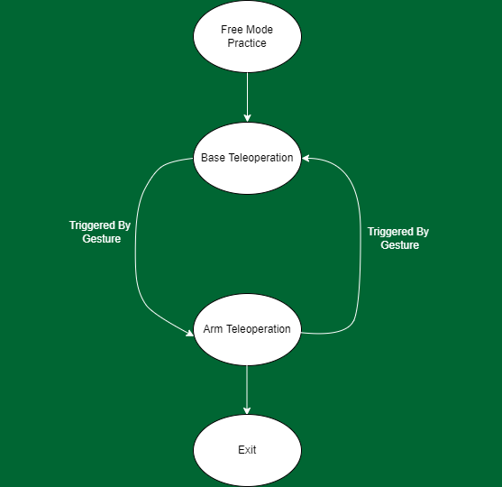
Free Mode - Practice
Simple FSM
The user has the possibility to switch between base and arm teleoperation via a gesture (e.g blinking eyes)
Thread for eyes blinking detection using Mediapipe
Switch GUI after three blinking
Cons: It is not usable by subjects with limited ability to control eye’s movements

Slide 40
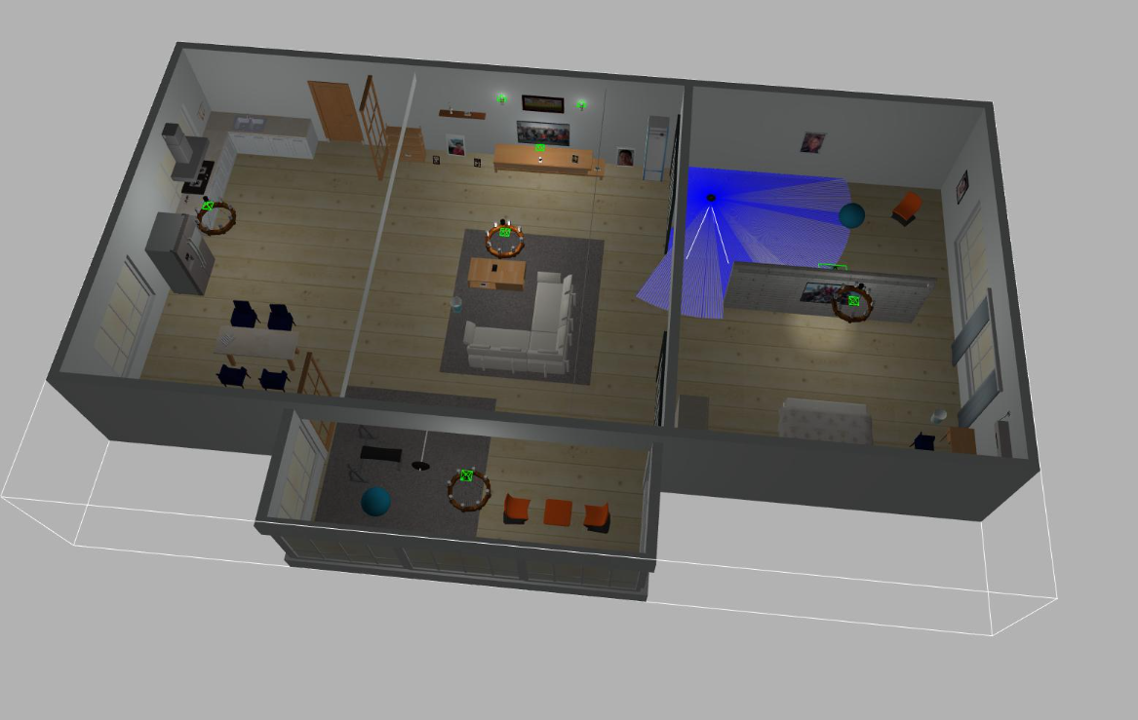
Free Mode - Practice
Simple FSM
The user has the possibility to switch between base and arm teleoperation via a gesture (e.g blinking eyes)
Thread for eyes blinking detection using Mediapipe
Switch GUI after three blinking
Cons: It is not usable by subjects with limited ability to control eye’s movements
Alternative: speach command
Simulation Enviroment
Dataset-of-Gazebo-Worlds-Models-and-Maps

Slide 41
Architecture and System Evaluation - Simulation Phase
In order to quantify the effectiveness of the architecture, several tests on subjects have to be done
Navigation task: the subject will has to travel a predetermined clocked path
Evaluation phase: each subject attempt will be compared with the time used to travel the path by TIAGo in autonomous way using dwa (Dynamic Window Approach) local planner
Manipulation task: the subject will has to pick and release on the table three objects
Evaluation phase: each subject attempt will be compared with an autonomous performance using OpenCV for object detection and IK manipulation
Expected results

Slide 42
Architecture and System Evaluation - Real Scenario
Only after that the subjects have obtained good results from the simulation enviroment, the test phase teleoperating the real TIAGo can start
Tests will be carried out into Santa Corona Hospital, Pietra Ligure, in particular into the spinal unit, on cSCI subjects with different mobility
Possibility to fully teleoperate TIAGo in the environment
As before will be evaluated the time needed for complete the tasks and its improvement (manipulation and navigation)
Will be evaluated the efficiency of the architecture for cSCI subjects assistance in daily activities
Will be evaluated the effort needed to complete the tasks
System Usability Scale (SUS)
Expected results

Slide 43
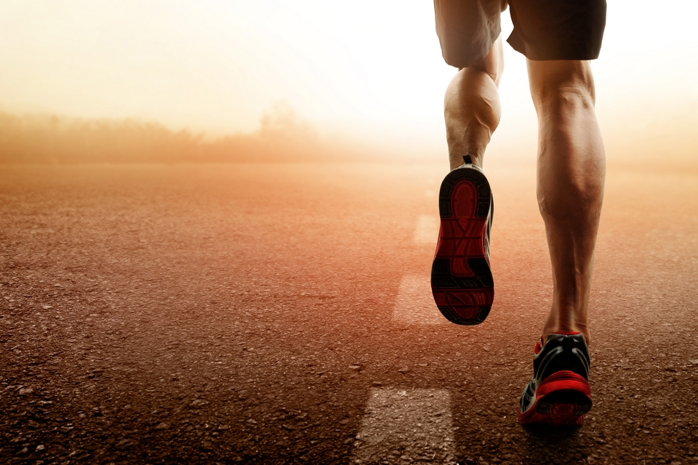
Architecture Features and Limitations
Flexible and accessible teleoperation for cSCI subjects assistance via BoMI
Prospective could be a problem
Simulation as a ‘game’ in order to stimulate subjects to practice with BoMI, as an active integration of a rehabilitative path and finally as a source of mental distraction.
Practice is required in order to efficiently interact with BoMI to carry out assistive tasks
Many autonomous components could be implemented
It is mandatory the use of two different machines otherwise the use of one machines and two screens

Slide 44
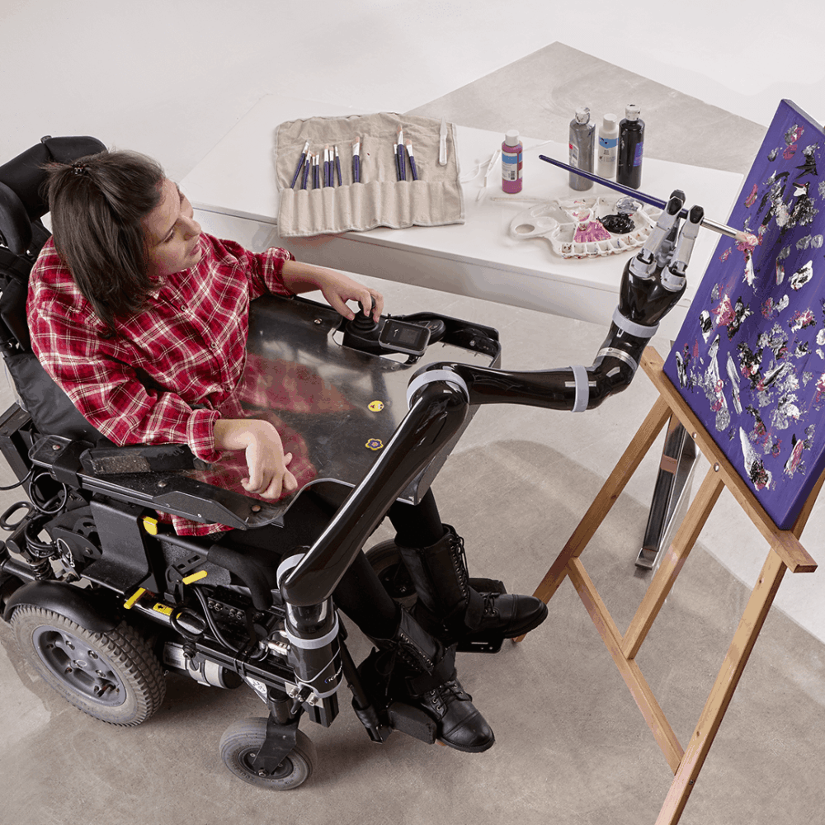
Future Implementations and Conclusion
Teleoperation trough BoMI of a powered wheelchair and an assistive manipulator
Implement Virtual Reality GUI for an immersive experience
Use BoMI in order to play video-games or simulators
THE KINOVA JACO assistive robotic arm

Slide 45
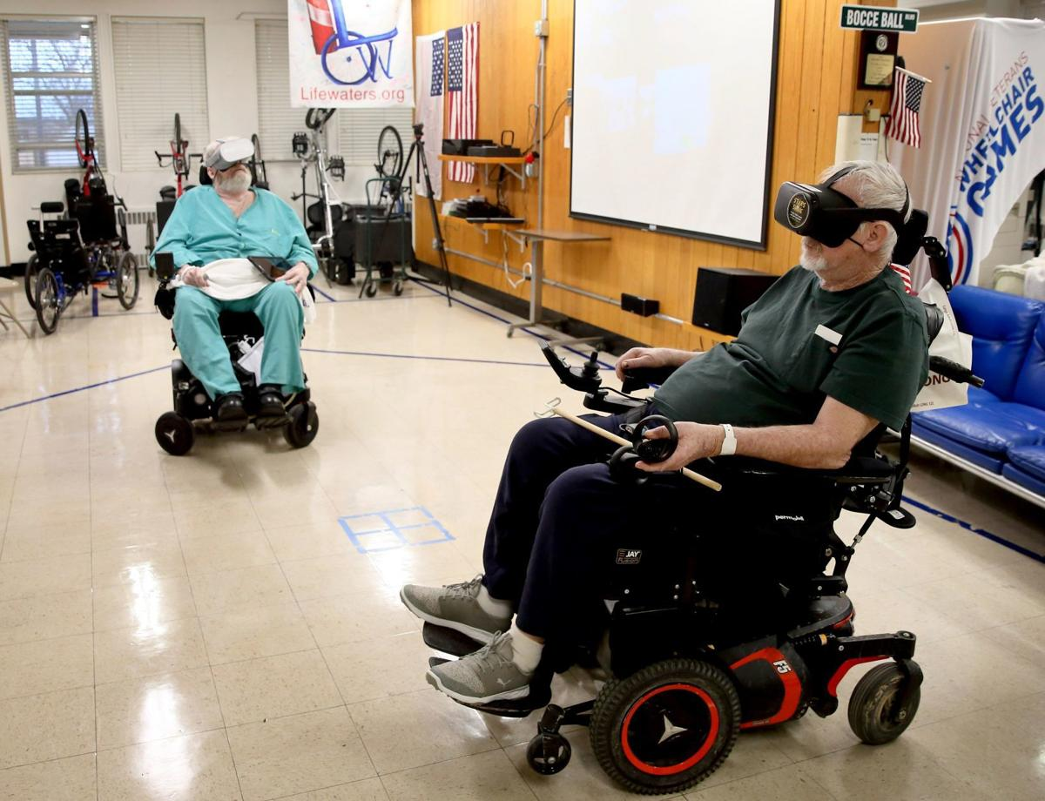
Future Implementations and Conclusion
Teleoperation trough BoMI of a powered wheelchair and an assistive manipulator
Implement Virtual Reality GUI for an immersive experience
VR techniques for neurorehabilitation using BoMI
Use BoMI in order to play simple video-games or simulators
St. Louis Post-Dispatch

Slide 46


THANKS FOR YOUR ATTENTION

